Slide 1
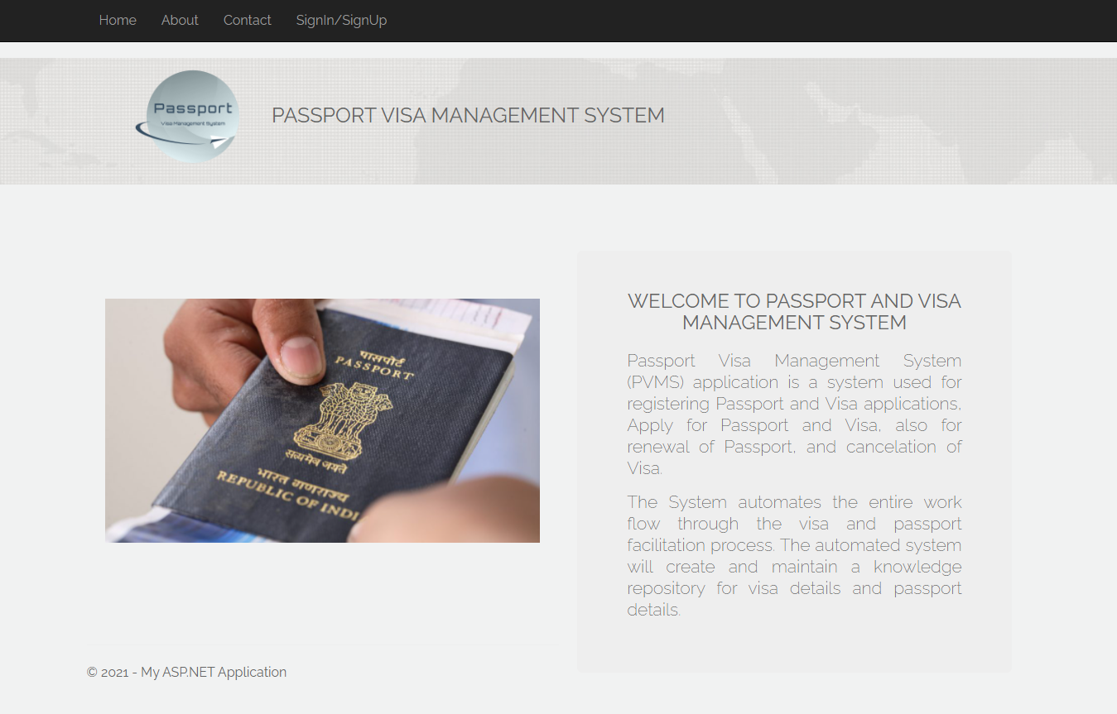

Slide 2
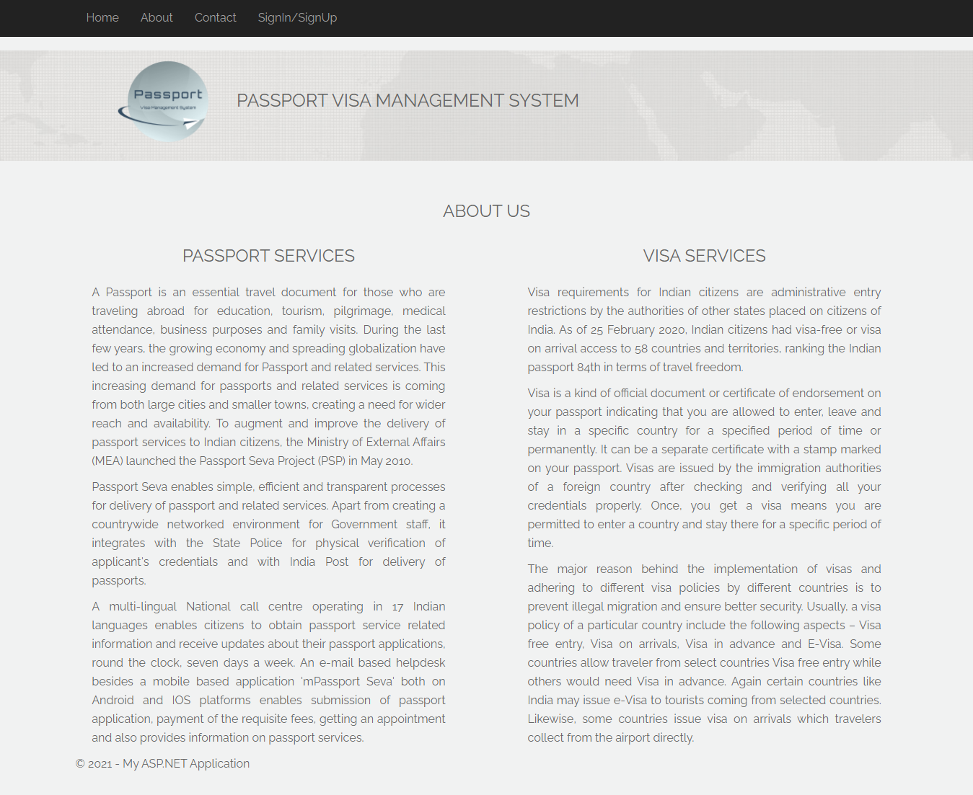

Slide 3
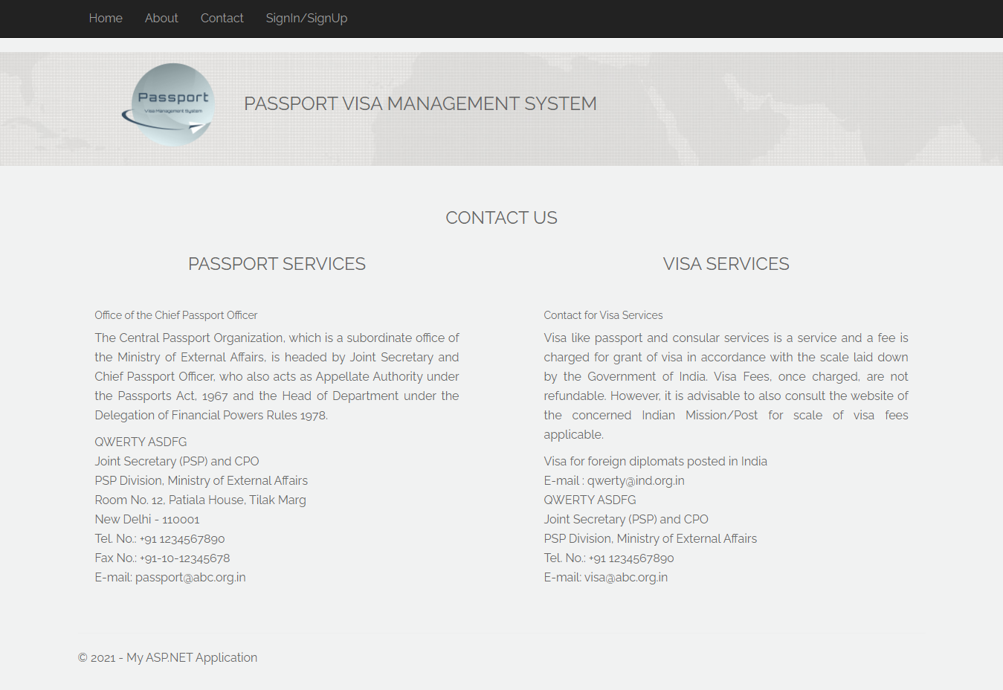

Slide 4
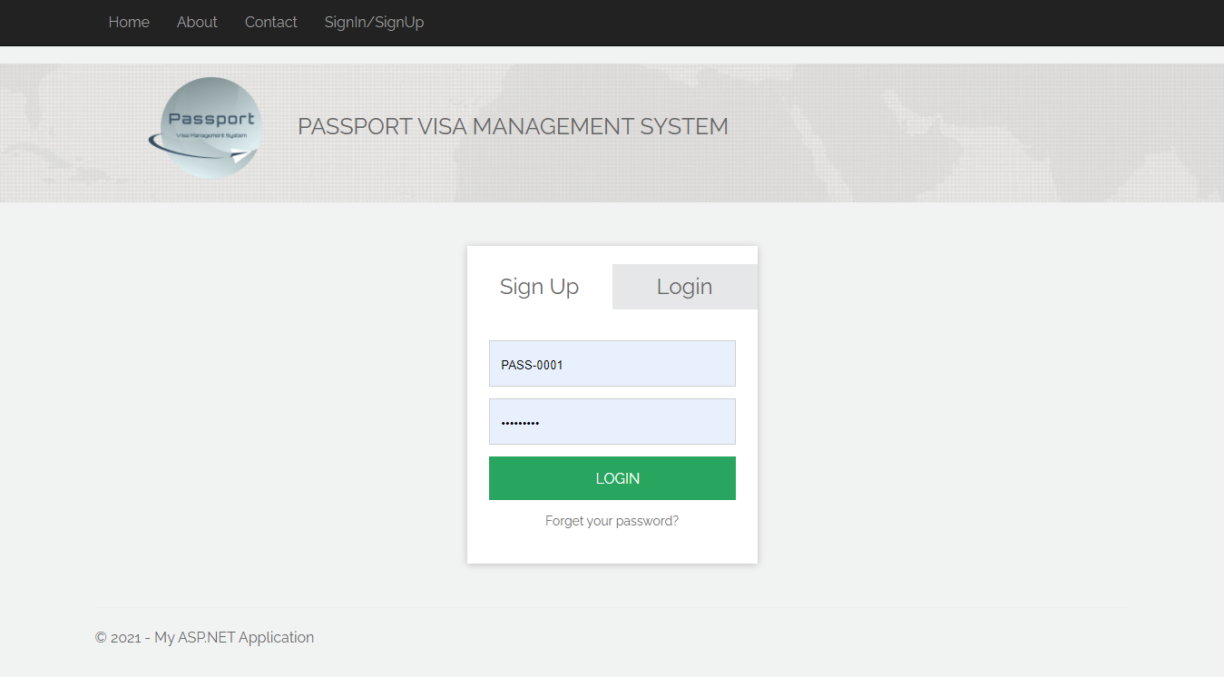

Slide 5
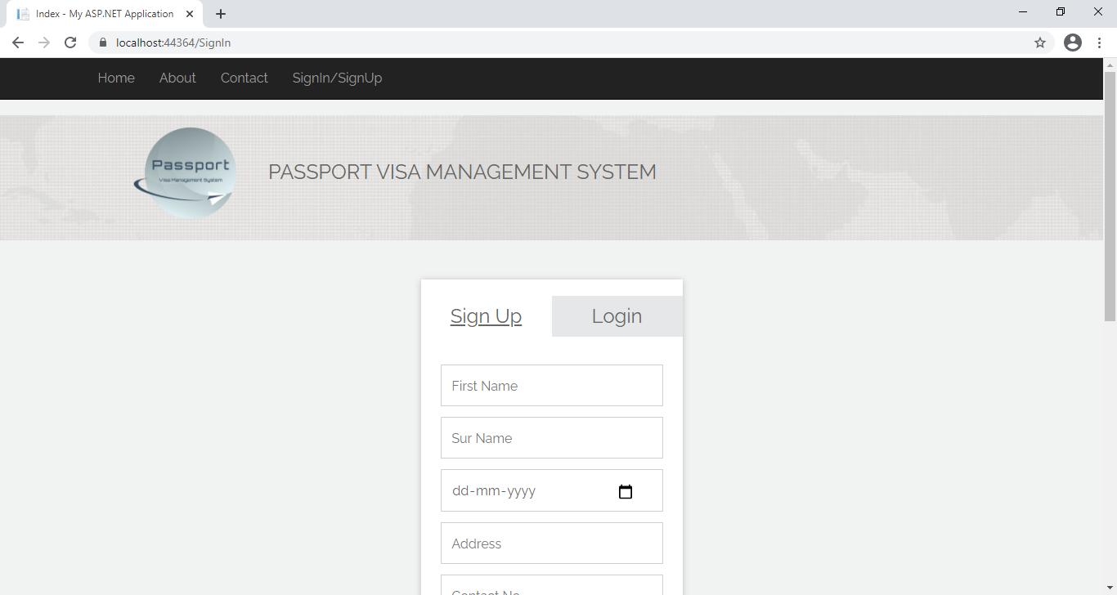
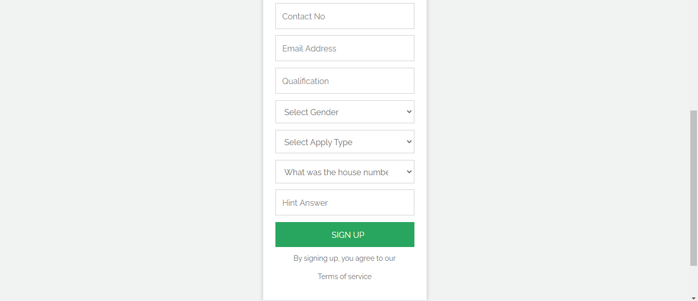

Slide 6
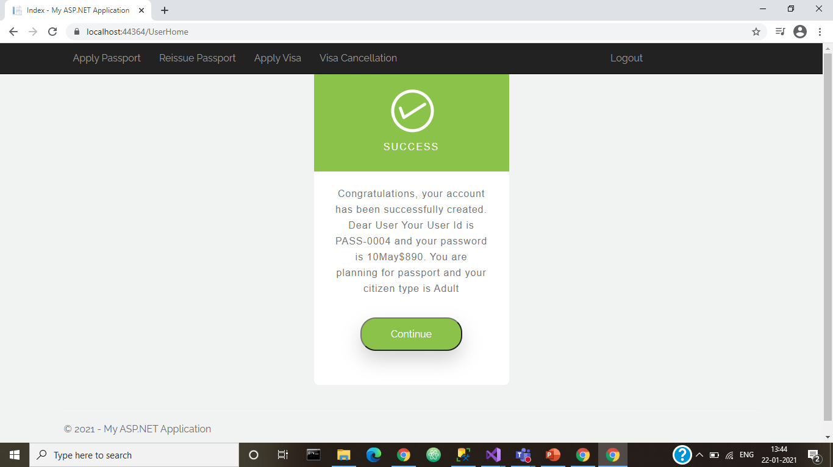
User Successfully Created. Give Id and Password to the user.

Slide 7
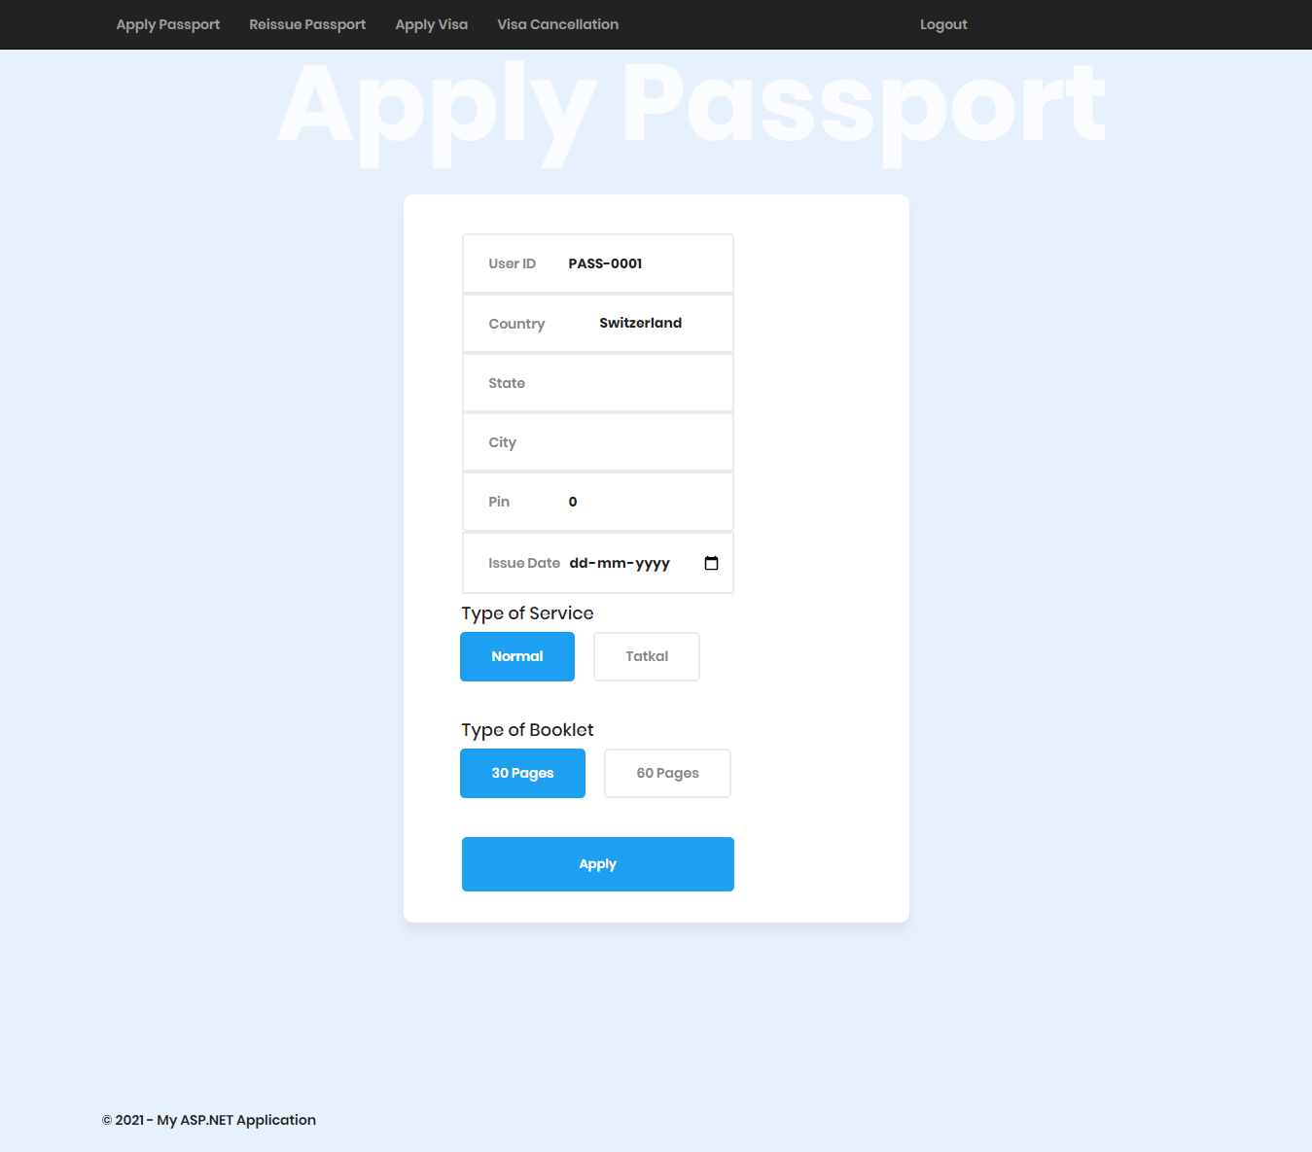

Slide 8

Passport Created. Provided Passport No and amount to pay

Slide 9
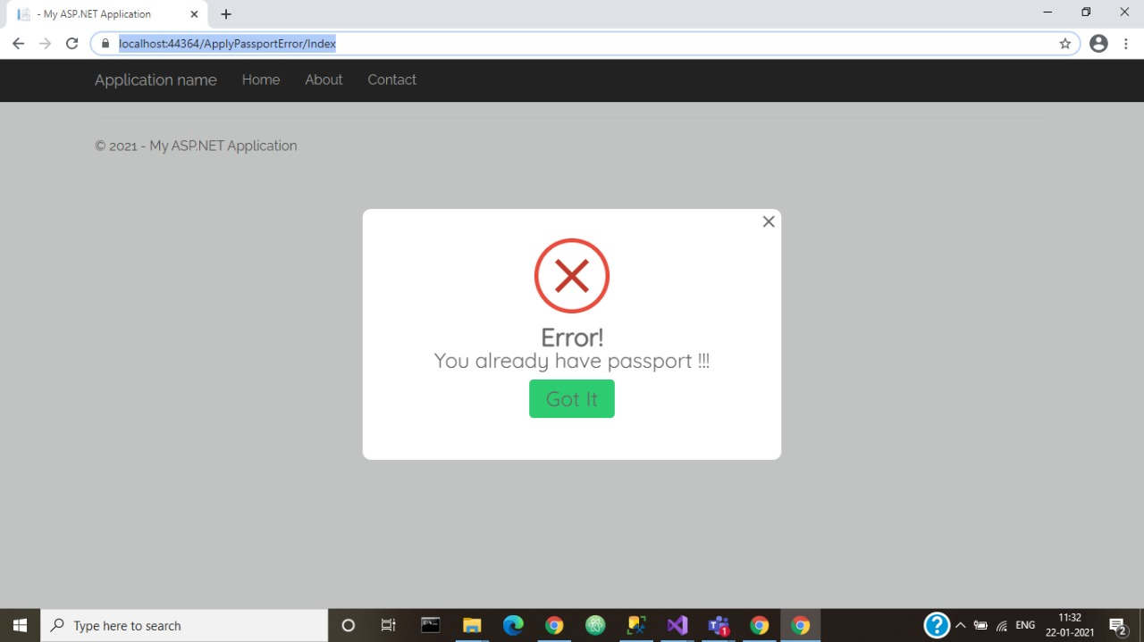
If User try to apply passport again on apply passport page, then he’ll get error message that he already has passport

Slide 10
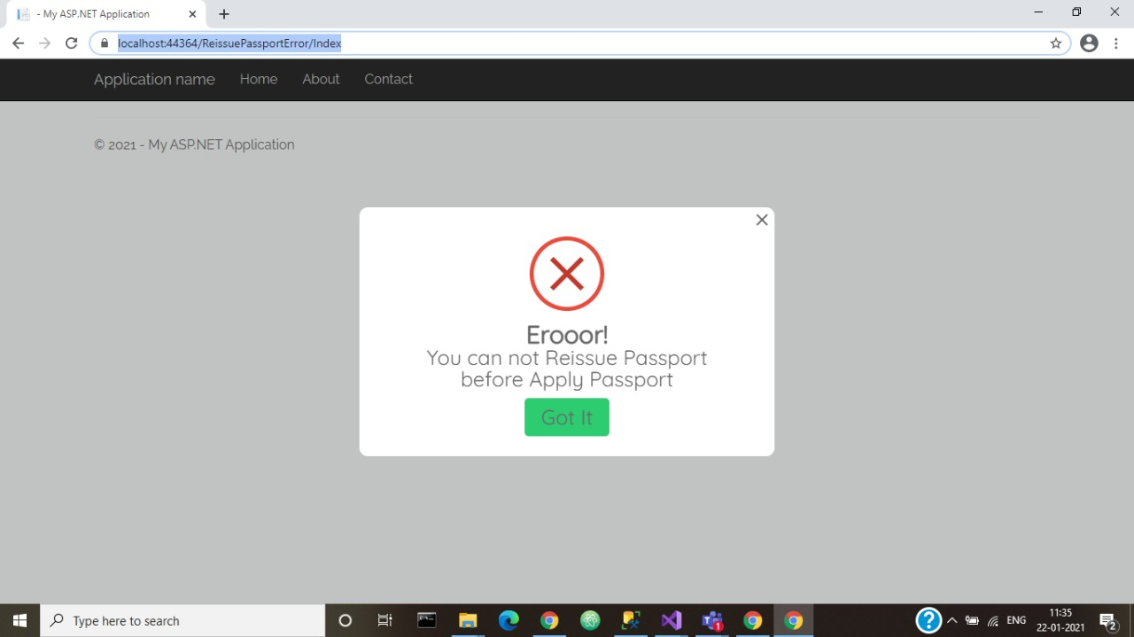
User Can’t Reissue Passport if he didn’t have passport in first place.

Slide 11
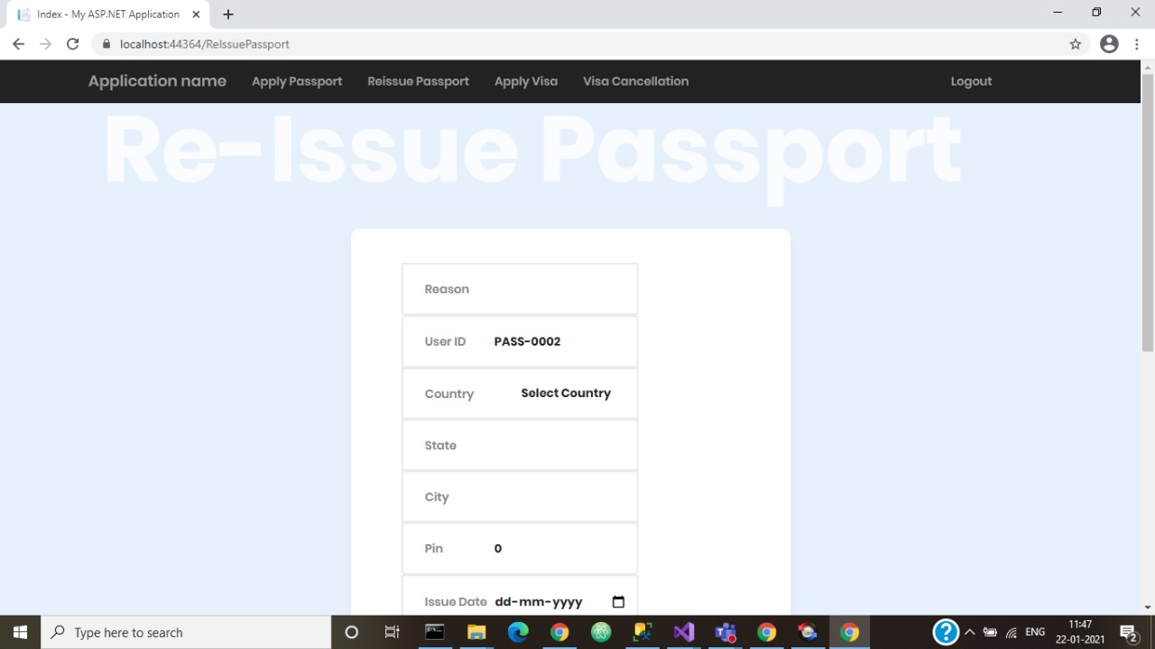


Slide 12
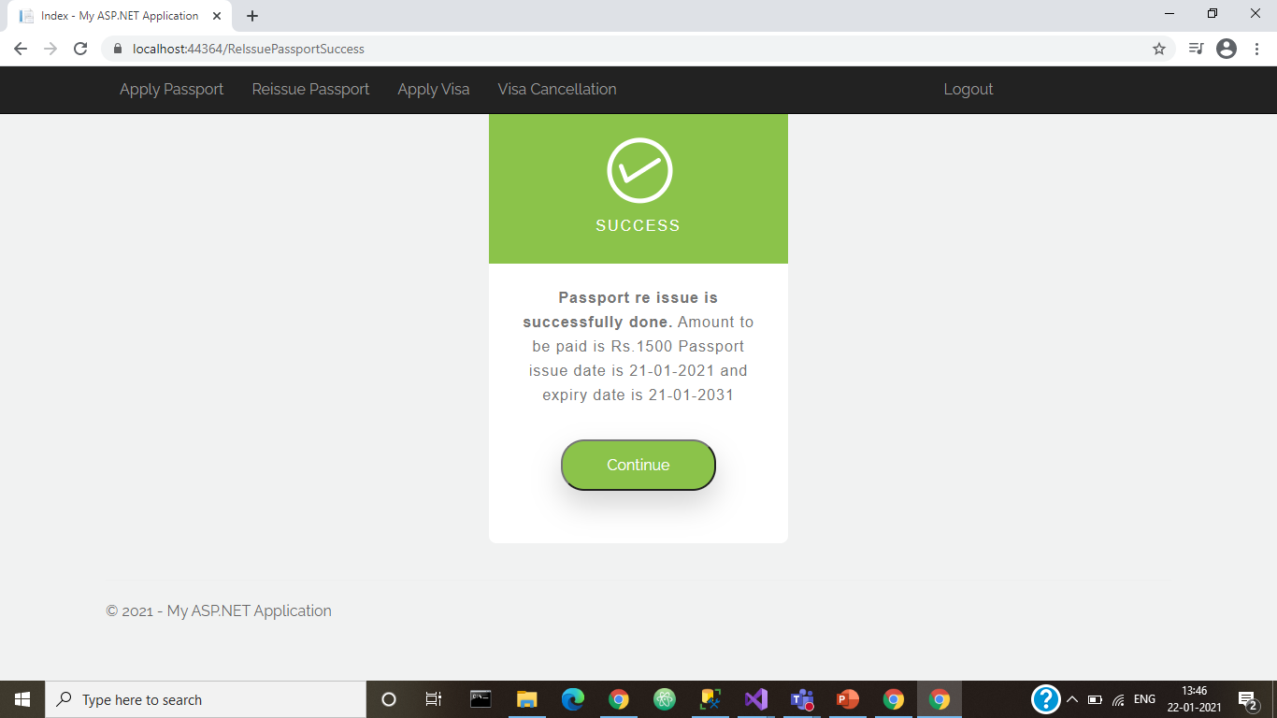
Passport reissue done. New passport No and amount to be paid is shown to user

Slide 13
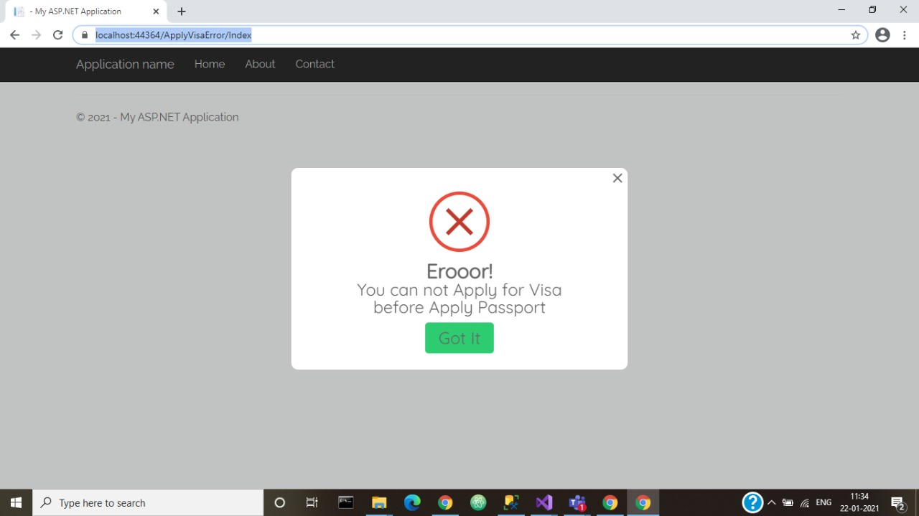
If user directly applied for visa without having passport then this error message will be displayed.

Slide 14
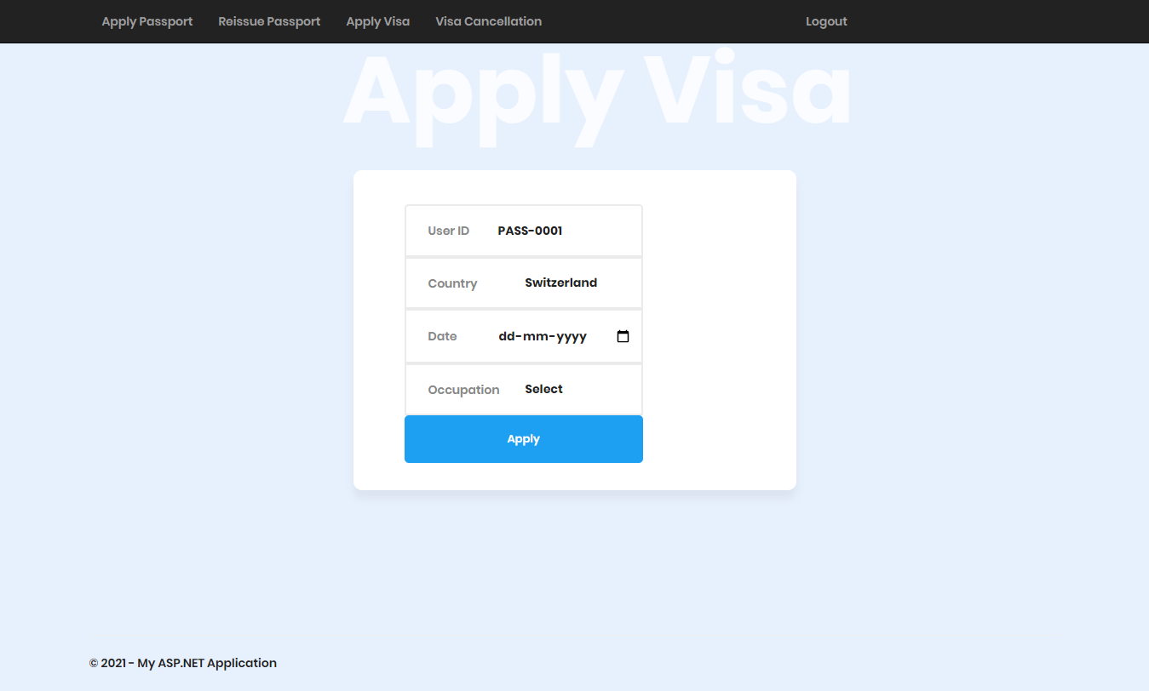

Slide 15
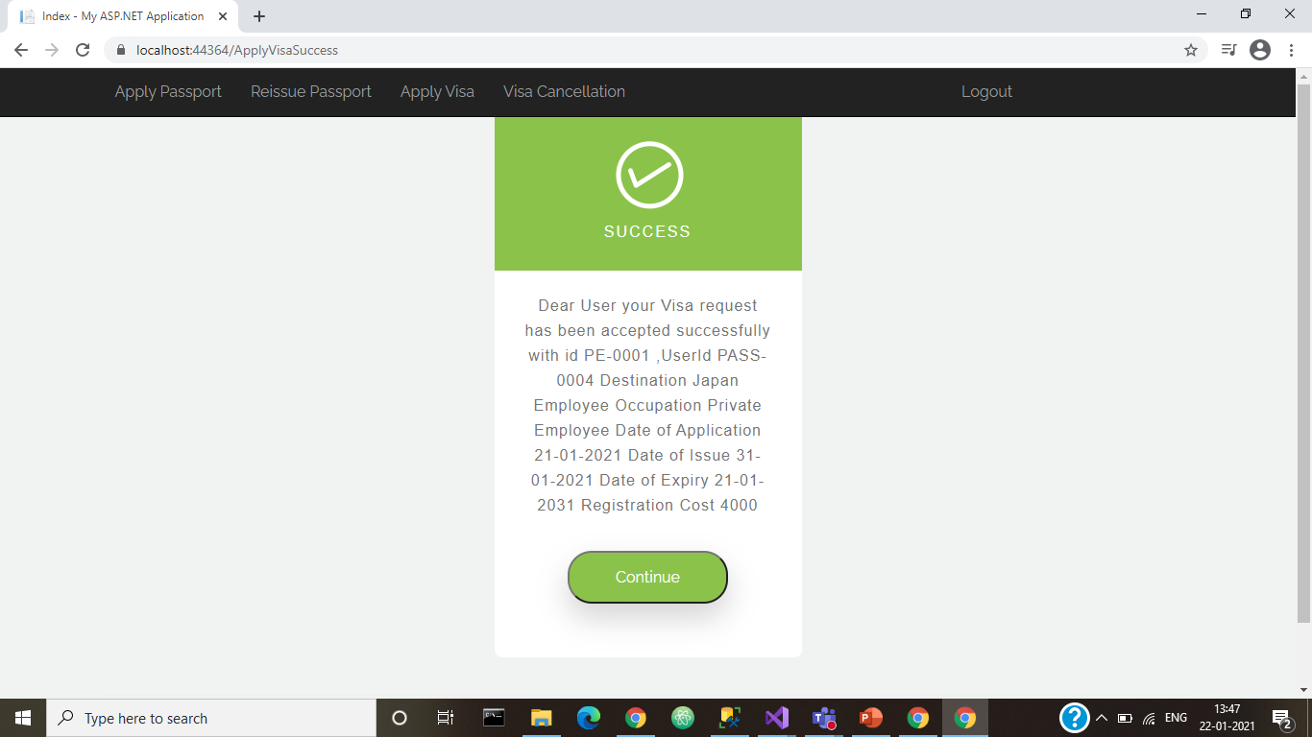
Visa applied successfully provided Visa number, Date of application, Date of issue and Date of expiry

Slide 16
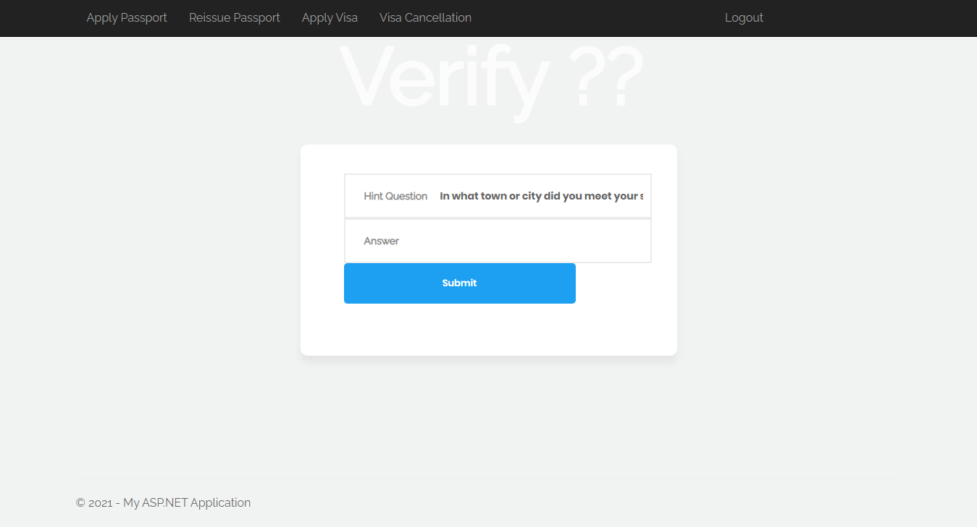

Slide 17

If User Didn’t apply for Visa then he can’t cancel the Visa Error message is shown to user.

Slide 18
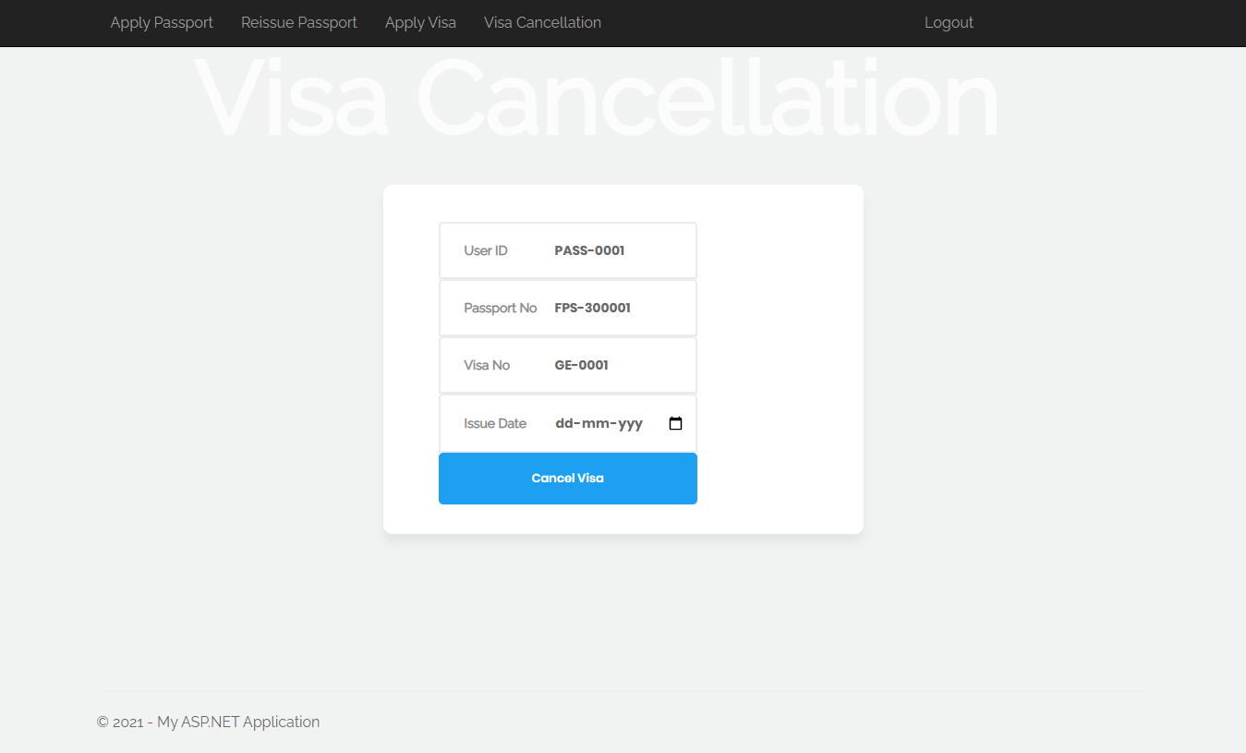

Slide 19
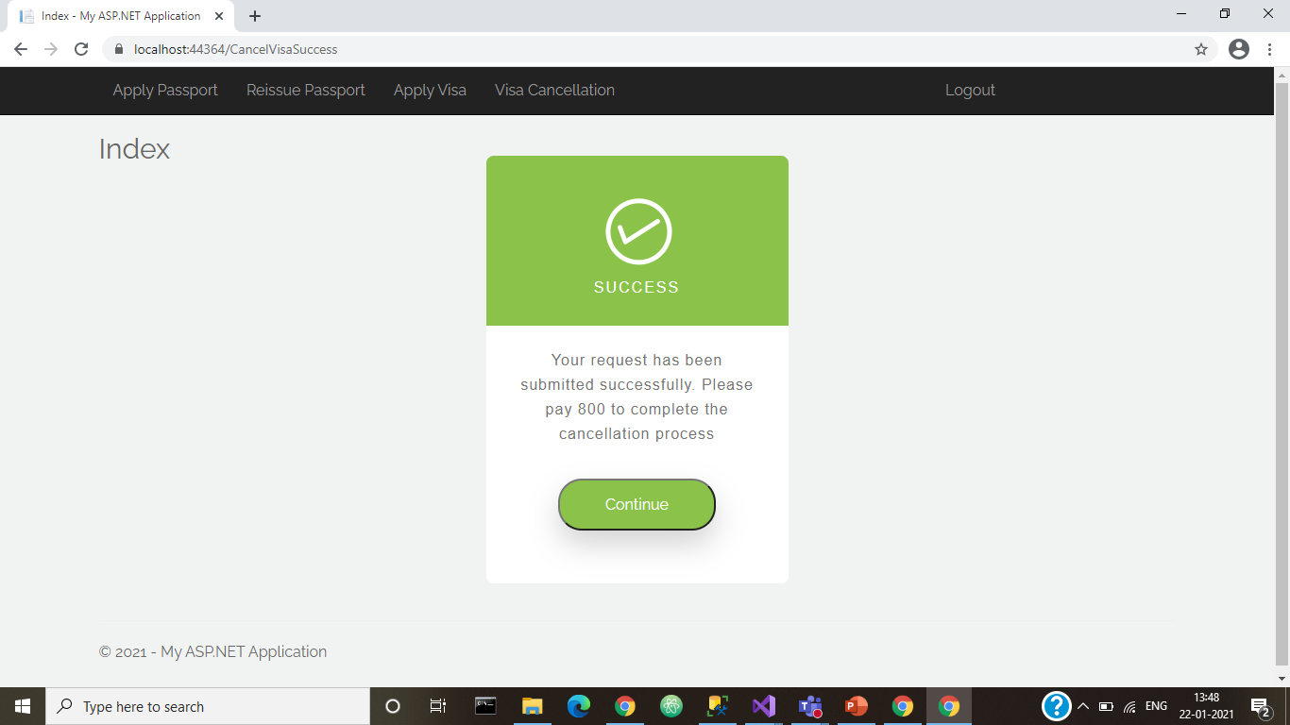
User Cancel the Visa After successfully give Authentication. Cancel Charge is shown to the user

